Slide 1
HNDIT2302
IT Project Management
Project Communications Management

Slide 2
Learning Objectives
Describe the importance of good communication on projects and major components of a communications management plan
Discuss various methods for project information distribution
Determine the number of communications channels needed for a project
Describe how software can enhance project communications

Slide 3

Project Communication Management
Project Communications Management includes the processes required to ensure timely and appropriate generation, collection, dissemination, storage and ultimate disposition of project information.

Slide 4
Project Communications
Management Processes
Communications planning: Determining the information and communications needs of the stakeholders.
Information distribution: Making needed information available to project stakeholders in a timely manner.
Performance reporting: Collecting and disseminating performance information, including status reports, progress measurement, and forecasting.
Managing stakeholders: Managing communications to satisfy the needs and expectations of project stakeholders and to resolve issues.

Slide 5
Communications planning
Every project should include some type of communications management plan, a document that guides project communications.
Communication management involves determining the information and communication needs of the stake holders: who needs what information, when they will need it, how it will be given to them, and by whom.
Creating a stakeholder analysis for project communications also aids in communications planning.

Slide 6
Communications planning
Inputs
Communications Requirements
Communications Technology
Tools and Techniques
Stake holder Analysis
Outputs
Communications Management Plan
Constraints
Assumptions

Slide 7
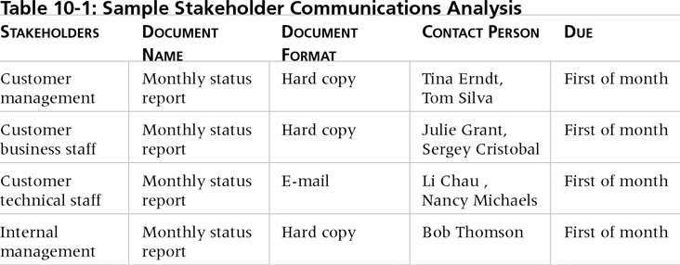
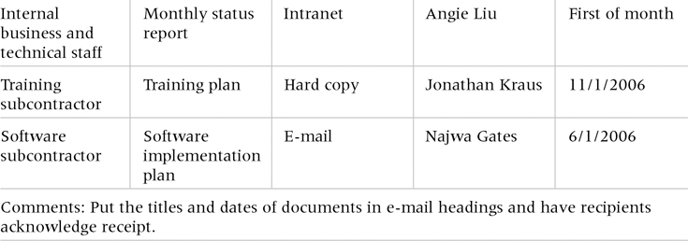
Sample Stakeholder Analysis for Project Communications

Slide 8
Information Distribution
Getting the right information to the right people at the right time and in a useful format is just as important as developing the information in the first place.
Important considerations include:
  Using technology to enhance information distribution.
  Formal and informal methods for distributing information.

Slide 9
Information Distribution
Inputs
Work Results
Communications Mgt Plan
Tools and Techniques
Communications skills
Outputs
Project Records
Project Plan
Information retrieval systems
Information distribution methods
Project Reports
Project Presentations

Slide 10
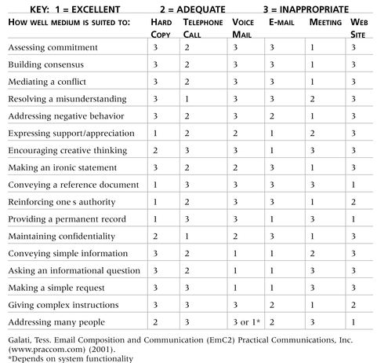
Media Choice Table

Slide 11
Determining the Number of Communications Channels
As the number of people involved increases, the complexity of communications increases because there are more communications channels or pathways through which people can communicate.
Number of communications channels = n(n-1)
2
where n is the number of people involved.

Slide 12
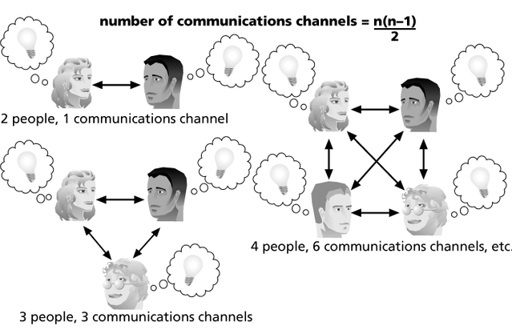
The Impact of the Number of People on Communications Channels

Slide 13
Performance Reporting
Performance reporting keeps stakeholders informed about how resources are being used to achieve project objectives.
  Status reports describe where the project stands at a specific point in time.
  Progress reports describe what the project team has accomplished during a certain period of time.
  Forecasts predict future project status and progress based on past information and trends.

Slide 14
Performance Reporting
Inputs
Project plan
Other project Records
Tools and Techniques
Performance Reviews
Variance Analysis
Outputs
Performance Reports
Change requests
Work results
Trend Analysis
Earned Value Analysis
Information distribution tools and techniques

Slide 15
Managing Stakeholders
Project managers must understand and work with various stakeholders.
Need to devise a way to identify and resolve issues.
Two important tools include:
  Expectations management matrix
  Issue log

Slide 16
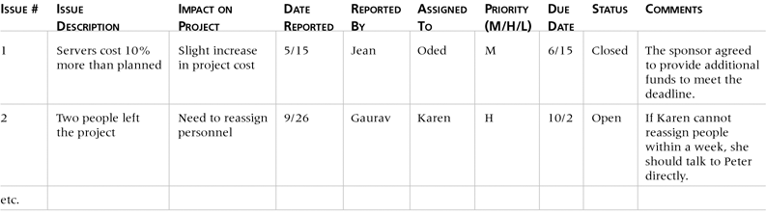
Issue Log

Slide 17

Suggestions for Improving Project Communications
Manage conflicts effectively.
Develop better communication skills.
Run effective meetings.
Use e-mail effectively.
Use templates for project communications.

Slide 18
Running Effective Meetings
Determine if a meeting can be avoided.
Define the purpose and intended outcome of the meeting.
Determine who should attend the meeting.
Provide an agenda to participants before the meeting.
Prepare handouts and visual aids, and make logistical arrangements ahead of time.
Run the meeting professionally.
Build relationships.

Slide 19
Using E-Mail Effectively
Make sure that e-mail is an appropriate medium for what you want to communicate.
Be sure to send the e-mail to the right people.
Use meaningful subject lines.
Limit the content to one main subject, and be as clear and concise as possible.

Slide 20
Using E-Mail Effectively (cont’d)
Limit the number and size of attachments.
Delete e-mail you don’t need, and don’t open e-mail if you question the source.
Make sure your virus software is current.
Respond to and file e-mails quickly.
Learn how to use important features.

Slide 21
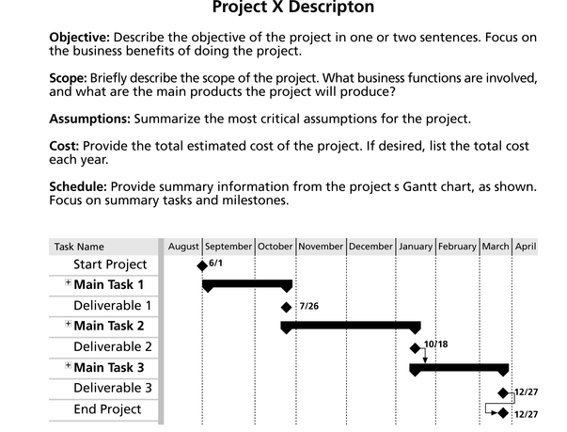
Sample Template for a
Project Description

Slide 22
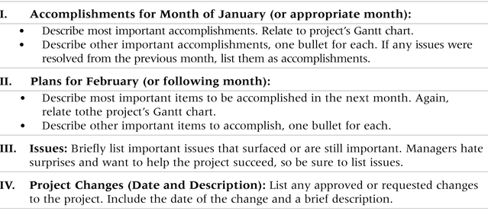
Sample Template for a Monthly Progress Report

Slide 23
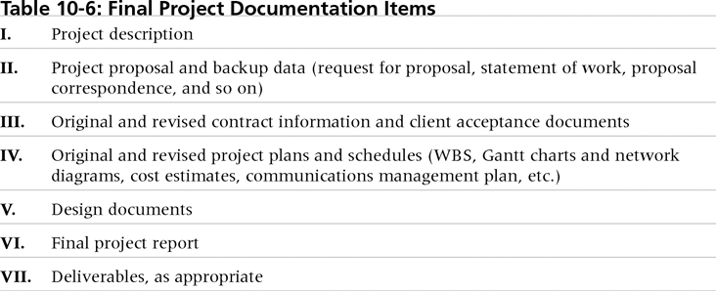
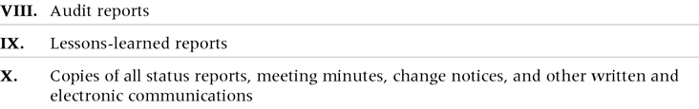
Final Project
Documentation Items

Slide 24
Lessons Learned Reports
The project manager and project team members should each prepare a lessons-learned report.
  A reflective statement that documents important things an individual learned from working on the project.
The project manager often combines information from all of the lessons-learned reports into a project summary report.
See template and sample in Chapter 3.

Slide 25
Project Web Sites
Many project teams create a project Web site to store important product documents and other information.
Can create the site using various types of software.

Slide 26
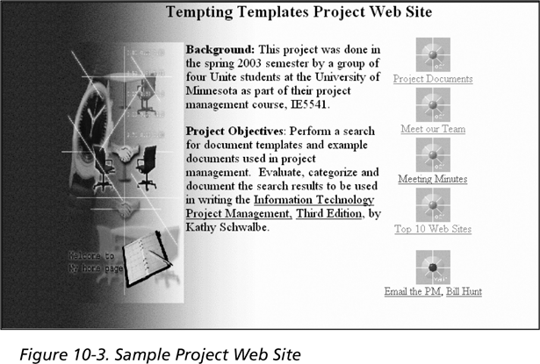
Sample Project Web Site

Slide 27
Developing a Communications Infrastructure
A communications infrastructure is a set of tools, techniques, and principles that provide a foundation for the effective transfer of information.
  Tools include e-mail, project management software, groupware, fax machines, telephones, teleconferencing systems, document management systems, and word processors.
  Techniques include reporting guidelines and templates, meeting ground rules and procedures, decision-making processes, problem-solving approaches, and conflict resolution and negotiation techniques.
  Principles include using open dialog and an agreed upon work ethic.

Slide 28
References
“Information Technology Project Management”, Kathy Schwalbe, sixth Edition, THOMSON Course Technology

